Slide 1
[ONLINE CINEMA TICKET BOOKING SYSTEM]
A Console-Based Booking Experience.
DONE BY: DEEPAK.B
DHANSHREE DHADGE
RUTH LOVELYN
Notes:
Be specific and direct in the title. Use the subtitle to give the specific context of the speech.
-The goal should be to capture the audience’s attention which can be done with a quote, a startling statistic, or fact. It is not necessary to include this attention getter on the slide.

Slide 2
INTRODUCTION
TO PROVIDE A SIMPLE CONSOLE-BASED APPLICATION FOR MOVIE TICKETS.
FEATURES:
LANGUAGE SELECTION
MOVIE SELECTION
THEATRE SELECTION
SHOW-TIME SELECTION
TICKET BOOKING
PAYMENT-METHOD OPTIONS
BOOKING CONFIRMATION
Notes:
Use the background points to post details that are not common knowledge, or that the audience will need to understand the context of the speech.
-Do not read these main points from the PowerPoint, instead elaborate on these points during the speech.

Slide 3
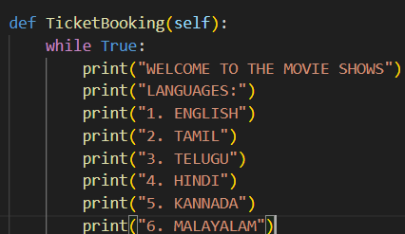
LANGUAGE SELECTION
LISTING GIVEN LANGUAGES
THIS CATEGORY SHOWS THE LIST OF AVAILABLE LANGUAGES.
USER CAN CHOOSE FROM SIX AVAILABLE LANGUAGES:
ENGLISH
TAMIL
TELUGU
HINDI
KANNADA
MALAYALAM

Slide 4
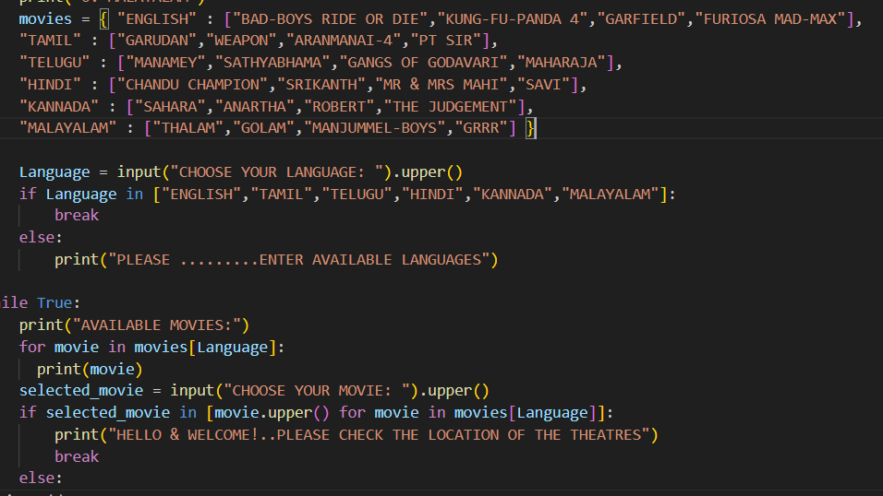
MOVIE SELECTION
LISTING AVAILABLE MOVIES
BASED ON THE SELECTED LANGUAGE, A LIST OF MOVIES IS DISPLAYED.
EXAMPLE [ENGLISH]:
BAD-BOYS RIDE OR DIE
KUNG-FU-PANDA- 4
GARFIELD
FURIOSA MAD-MAX

Slide 5
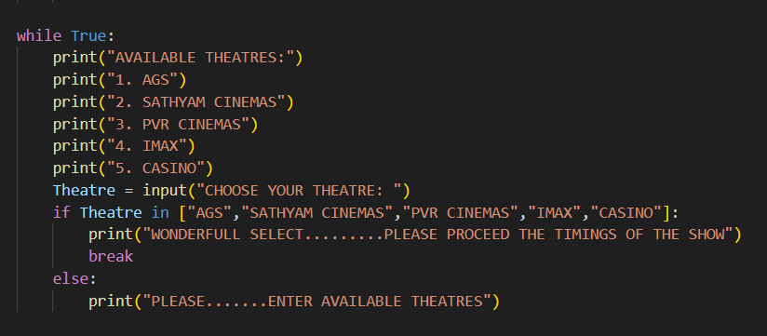
THEATRE SELECTION
LISTING AVAILABLE THEATRES.
USER CAN CHOOSE FROM THE FOLLOWING THEATRES:
AGS
SATHYAM CINEMAS
PVR CINEMAS
IMAX
CASINO

Slide 6
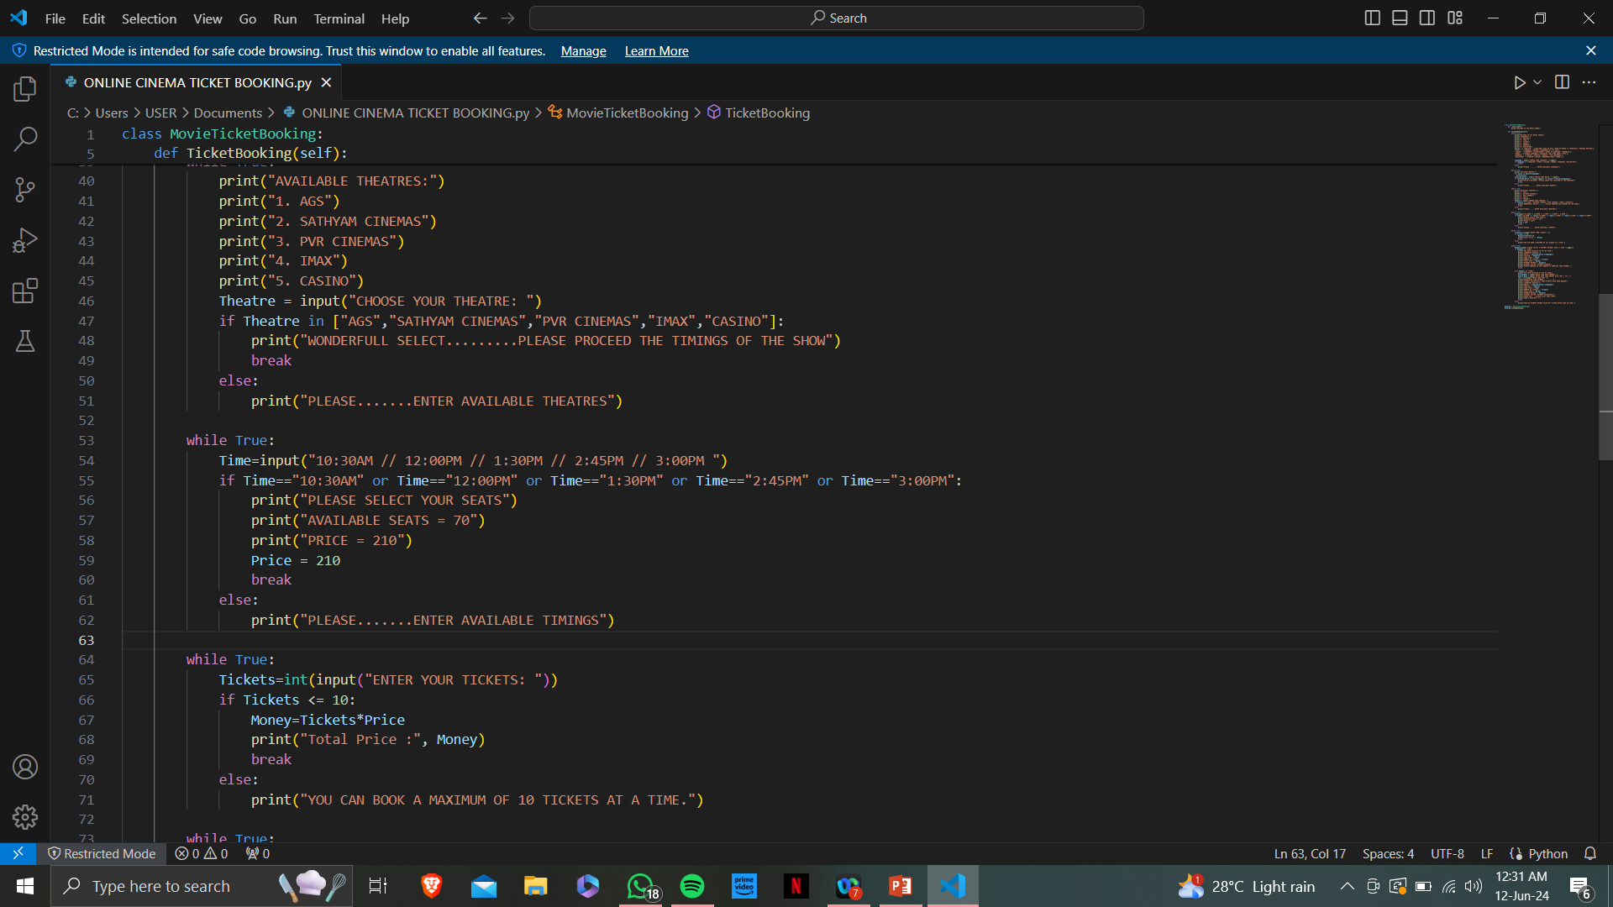
SHOW TIME SELECTION
SHOWING PARTICULAR TIME SLOTS OF A SELECTED MOVIE
IT SHOWS USER CAN CHOOSE A SHOWTIME
IT WILL SHOWS THE AVAILABLE TIME SLOTS:
10:30 AM
12:00 PM
1:30 PM
2:45 PM
3:00 PM

Slide 7
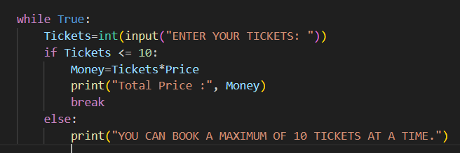
TICKET BOOKING
DESCRIBING THE TICKET BOOKING PROCESS.
TICKET BOOKING:
USERS CAN BOOK A MAXIMUM OF A 10 TICKETS AT A TIME.
EACH TICKET COST ₹210.
TOTAL PRICE IS CALCULATED BASED ON THE NUMBER OF TICKETS.

Slide 8
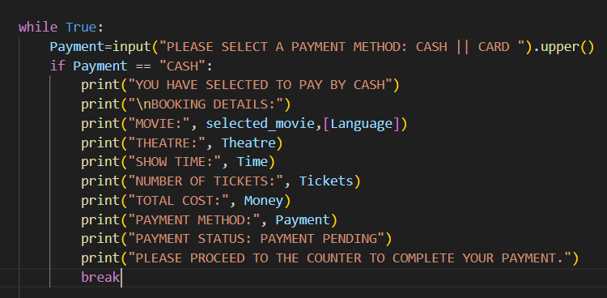
PAYMENT METHOD [CASH]
USER CAN CHOOSE TP PAY BY CASH:
BOOKING DETAILS ARE DISPLAYED
ALSO PAYMENT STATUS IS MARKED AS [“PAYMENT PENDING”]
USER IS INFORMED TO PROCEED TO THE COUNTER TO COMPLETE THE PAYMENT.
IF USER IS CHOOSING TO PAY BY USING [CASH]
Notes:
The title of main point #1 should be clear and concise. Each piece of evidence should be summarized for clarity and cited correctly. Do not simply read the pieces of evidence, but elaborate where needed.
[type notes for elaboration here]
Be sure to transition to main point #2 and the next slide.

Slide 9
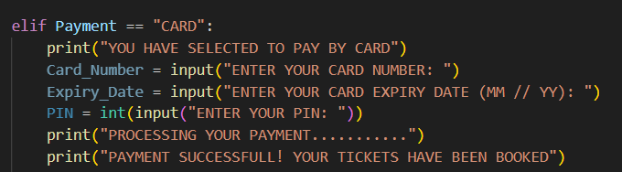
PAYMENT METHOD [CARD]
USER CAN CHOOSE TO PAY BY USING CARD:
ENTERING THE CARD NUMBER
ENTERING THE EXPIRY DATE
ENTERING THE PIN
PAYMENT WILL BE PROCESSING
PAYMENT STATUS WILL BE UPADTED ACCORDINGLY.
IF USER IS CHOOSING TO PAY BY USING [CARD]

Slide 10
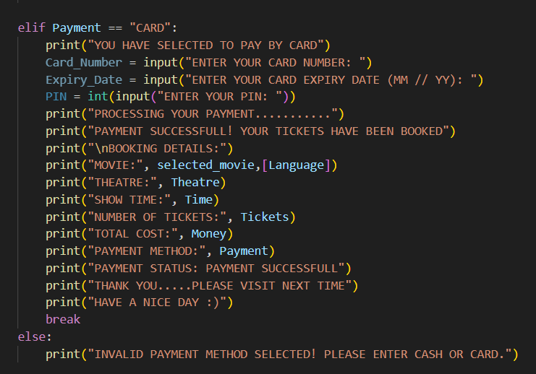
BOOKING CONFIRMATION
CONFIRMING THE BOOKING CONFIRMATION OF THE USER.
BOOKING CONFIRMATION:
IT DESCRIBES THE FINAL STEP WHERE BOOKING DETAILS ARE SHOWN:
MOVIE NAME
THEATRE
SHOW TIME
NUMBER OF TICKETS
TOTAL COST
PAYMENT METHOD
PAYMENT STATUS

Slide 11
[ THANK YOU ]
MAIN POINTS COVERED IN THE PRESENTATION, AS WELL AS COMPREHENSIVE BOOKING PROCESS OF THE APPLICARTION.
Notes:
Dedicate this entire slide to the thesis statement. It is the reason the speech is being given. Use this time to reveal the three main points of the speech (slides 4,5,6) as an overview for the direction of the speech:
-[type main point #1 here]
-[type main point #2 here]
-[type main point #3 here]
Be sure to transition to the first main point and the next slide.

